Slide 1
Understanding Restaurant Stories Using an ASP Theory of Intentions
Qinglin Zhang and Daniela Inclezan
Miami University, Oxford OH 45056, USA

Slide 2
Objective
Understand Narratives
They start from Eric Mullers Work (texts of stereotypical activities)
Restaurant Stories
The authors claim that Eric Mullers work/theory/system could not handle exceptional cases.
Or rather would try but not process them correctly.

Slide 3
Eric Mullers Work
“Mueller developed a system that can take as an input a text about a restaurant episode, process it using in-formation extraction techniques, and demonstrate a deep understanding of the narrative by answering questions whose answers are not necessarily explicitly stated in the text”.
“The system had a good accuracy but the rigidity of scripts did not allow for the correct processing of scenarios de- scribing variations (e.g., several dishes being ordered) nor exceptions (e.g., waiter bringing a wrong dish)”.

Slide 4
Solution: Answer Set Prolog
Theory of Intentions developed by Blount, Gelfond, and Balduccini.
Model Restaurant Scripts as activities and sort of introduce the concept of an intentional agent
Notes:
Mention drawbacks here. The fact that the authors cater to ASP audience. No NLP, no Real intentions, no multi-agents, narratives and not actual activities.

Slide 5
What the Authors Claim to Do
The Application of Logic Programming
Restaurant Narrative:
“The customer enters, he is greeted by the waiter who leads him to a table, the customer sits down, reads the menu, orders some dish, the waiter brings the dish, the customer eats and then asks for the bill, the waiter places the bill on the table, the customer pays and then leaves”

Slide 6
Stereotypical activities
According to Schank and Abelson [13], stories frequently narrate episodes related to stereotypical activities –
“sequences of actions normally performed in a certain order by one or more actors, according to cultural conventions”.
Reader is capable of filling in the blanks with his own commonsense knowledge

Slide 7
What is an Intentional Agent
As an agent that intends to perform some actions in order to achieve a goal, but may not always need to/ be able to perform them as soon as intended
Blount et al. [5,6] that introduces the concept of an activity - a sequence of agent actions and sub-activities that are supposed to achieve a goal.

Slide 8
Why ASP?
It can be easily coupled with ASP commonsense knowledge bases about actions and their effects, and with reasoning algorithms encoded in ASP or its extensions, to build executable systems.
Also, because
Blount et al.'s theory of intentions is written in an action language and is translatable into Answer Set Prolog (ASP)
Not aware of any other logic programming theories of intentions that can be immediately integrated in executable systems.

Slide 9
AIA Architecture
According to AIA, at each time step, the agent observes the world, explains observations incompatible with its expectations (diagnosis), and determines what action to execute next (planning).

Slide 10
Scenarios
Nicole went to a vegetarian restaurant. She ordered lentil soup. The waitress set the soup in the middle of the table. Nicole enjoyed the soup. She left the restaurant
Seated by Waiter
Customers are supposed to pay for their food.
Nicole went to a vegetarian restaurant. She ordered lentil soup. When she waitress brought her the soup, she told her that it was on the house.
The customer did not pay for the soup. (Serendipity)
Nicole went to a vegetarian restaurant. She sat down and wanted to order lentil soup, but it was not on the menu.
The customer stopped her plan of eating lentil soup (detection of futile activity)

Slide 11
Contd..
Nicole went to a vegetarian restaurant. She ordered lentil soup. The waitress brought her a miso soup instead.
Explanations: Cook misunderstood or Waiter misunderstood (Diagnosis)

Slide 12
What is Same and/or different from AIA?
Reasoning process of Agent vs Cautious Reader (who wants to infer things about the intentional agent)
“one of our goals in this work is to understand what parts of the AIA architecture can be adapted to our purposes of modeling the reasoning of a narrative reader and how”
Difficulties: Many actions not specified in story(fewer time points on story time line than reasoning time line)
Many Agents (to simplify this they use older theory of intentions Baral and Gelfond to model the intended sequences of actions for secondary characters)

Slide 13
What exactly was Eric Mullers Work?
Answer questions about time & space aspects that were not necessarily covered/mentioned in text -> but inferred
It required the following background knowledge:
A commonsense knowledge base about actions occurring in a restaurant, their effects and preconditions, encoded in Event Calculus
A script describing a sequence of actions performed by different characters in a normal unfolding of a restaurant episode.

Slide 14
How of the previous Slide
The system processed English text using information extraction techniques in order to fill out slot values in a template.
The slot CUSTOMER would be labelled with value Nicole
SCRIPT: LAST EVENT with Leave
Arrive, Sit, ReadMenu, Order, Serve, Eat, RequestBill, ReceiveBill, Pay, are other possible values
This template was translated into a reasoning problem:
FACTS ABOUT ENTITIES
FACTS ABOUT CONSECUTIVE OCCURENCES OF ACTIONS IN SCRIPT
FACTS ABOUT DEFAULT LOCATIONS FOR OBJECTS, CHARACTERS ETC

Slide 15
Contd..
The reasoning problem + common sense knowledge in knowledge base = compute models
Questions about time and space aspects were answered using these models.
Small Reading!

Slide 16
What is Different than Activity Recognition
Does not require identifying an agent's goal
(which is always the same in their case)

Slide 17
Preliminary on Theory of Intentions: Old Theory
Normally intended actions are executed the moment such execution becomes possible (non-procrastination) and Unfulfilled intentions persist (persistence).
Sequence sequence(s)
Length length(n, s)
Component component(s, k, x)
Intention of Agent at time point intend(x, i)
Reading!

Slide 18
New Theory of Intentions
Each sequence of actions of an agent was associated with a goal that it was meant to achieve, the combination of the two was now called an activity
activity(m) (m is an activity);
goal(m, g) (the goal of activity m is g);
length(n, m) (the length of activity m is n);
component(m, k, x) (the kth component of activity m is x, where x is either an action or a sub-activity).
“only attempts to perform those actions that are intended and does so without delay.”

Slide 19
Addition of Mental Fluent and Mental Actions
status(m, k)
next_action(m, a)
Select(g)
Abandon(g)
Start(a)
Stop(a)
Blount et al. developed an agent architecture AIA (implemented in CR-Prolog, an extension of ASP) that adapts the agent loop to accommodate an intentional agent. – handles exceptions

Slide 20
Methodology
Strict focus on Reasoning: NO NLP!
Assumption:
Common sense KB is available (orthogonal to goal)
1 main character, 1 character for every important goal, 1 dish (they claim it is the first attempt to use theory of intentions to model exceptional cases)

Slide 21
Steps
Input Text -> logic program -> answer sets (models of text for question answering)
Logic program -> predefined part + input text part

Slide 22
Predefined Part
The cKB knowledge base, with a core describing sorts, fluents, actions, and some pre-defined objects relevant to the stereotypical activity of focus
A module encoding the stereotypical activity as an activity of newTI for the main character
Sequences of oldTI for the remaining characters
A Reasoning module
A mapping of time points on the story time line into points on the reasoning time line
Reasoning components adapted from the AIA architecture to reflect a reader's reasoning process and expected to allow reasoning about serendipitous achievement of goals, decisions to stop futile activities, and diagnosis.

Slide 23
Input-dependent Part
Facts defining objects mentioned in the text as instances of relevant sorts in the cKB (including who the main character is, etc)
Observations about the values of fluents and the occurrences of actions at different points on the story time line.
Default information about the values of uents in the initial situation.

Slide 24
Common Sense Knowledge Base
Hierarchy of Sorts – Thing vs Location
person, food, restaurant, and bill where person has sub-sorts customer, waiter, and cook.
The customer, the waiter, the food, and the restaurant, denoting the main customer, the waiter, food, and restaurant in the text, respectively
Entrance, kitchen, counter, outside are instances of location
M – unique menu
T – unique table (both location and thing)
B – main customer’s bill

Slide 25
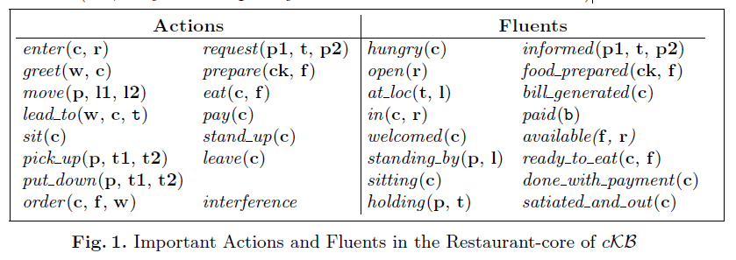
CONCEPT OF INTERFERENCE and fluents
Interference is an example of an exogenous action (not an agent action) that can be relevant for diagnosis.
All fluents are inertial (i.e., they normally maintain their previous values unless changed by an action)
ready to eat(c, f ), done with payment(c), and satiated and out(c), are defined (i.e., they are completely defined in terms of other fluents)

Slide 26
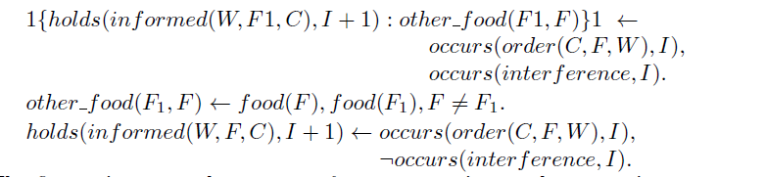
Contd..

Slide 27
Encoding Activities
The reader only views the main character as a goal-oriented agent and assumes that all other characters are not

Slide 28
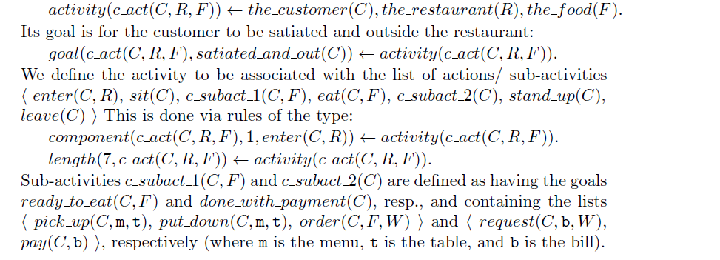
Customer Activities

Slide 29
Waiter Sequences
Introduce objects of the form w_seq(W,C, F1, F2)
Waiter intends only 1 such sequence
greet(W,C), lead to(W,C, t), move(W, t, kitchen), request(W, F1, ck),
pick up(W, F2, kitchen), move(W, kitchen, t), put down(W, F2, t), move(W, t, counter), pick up(W, b, counter), move(W, counter, t), put down(W, b, t).

Slide 30
Cook Sequences
ck seq(Ck, F, W)
prepare(Ck, F, W)
actor(s, ac)

Slide 31

Default Information
hpd(select(satiated_and_out(C)), true, 0) <- the customer(C):
hpd(start(c_act(C,R, F)), true, 1) <- activity(c_act(C, R, F))
Reading?!

Slide 32
Reasoning Module
AIA architecture with NewTI – adapt certain parts and add rules to it!
History mapped into occurs and holds. For this they import the temporal projection & diagnostic module of AIA
Adding new Rules – Mapping story time line to reasoning time line

Slide 33
4 Categories: From AIA to RM
No Goal or Activity to Commit to: In AIA, the agent waits. AIA category 1 histories are not relevant to RM.
Top-level activity is active but its goal is not: In AIA, the agent stops the activity. (Serendipitous achievement)
Rules relevant included in RM
A top-level activity and its goal are active
Performs next action (relevant rules imported to RM)
Unless activity is futile (In AIA activity is stopped, in RM definition of futile activity is changed, reading - important!)

Slide 34
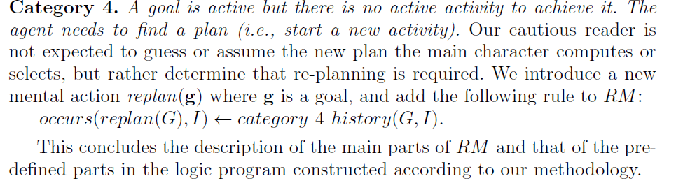
Last Category
A goal is active but there is no active activity to achieve it. The agent needs to find a plan (i.e., start a new activity).

Slide 35
Logic Form
Definitions of instances of sorts the customer, the waiter, the food, food, the restaurant
if the name of one of these entities is not given in the text, then it is replaced by a new constant (e.g., cook1)
observations about the values of fluents and occurrence of actions in relation to the story time line.
Using Rules described
+DEFAULT OBSERVATIONS (Customer is hungry, restaurant is open etc)

Slide 36
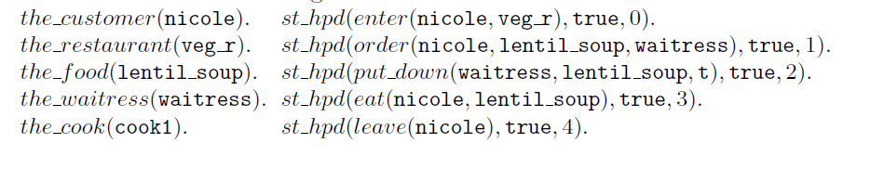
Contd..

Slide 37
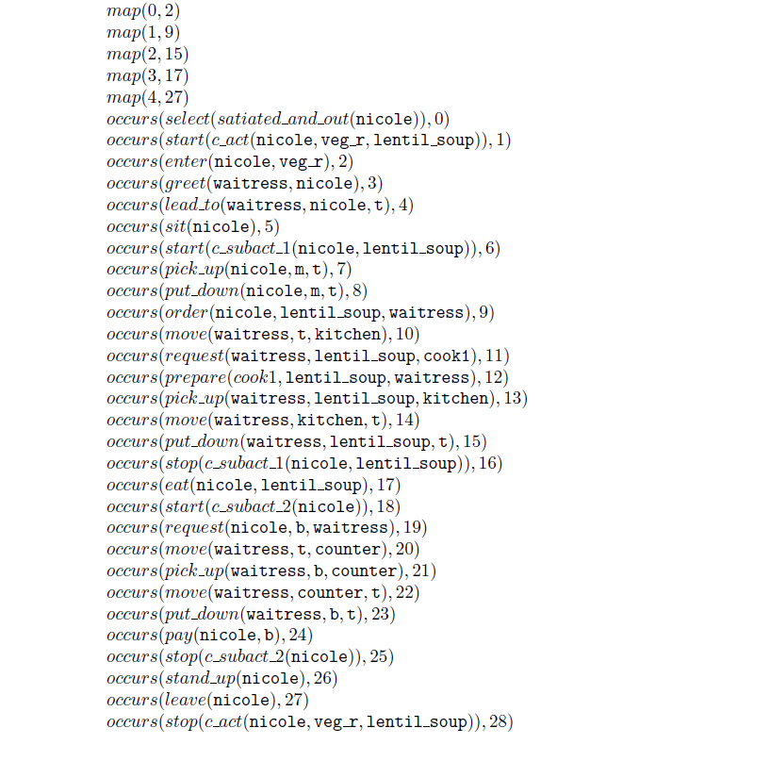
Normal Scenario
Mental actions are starting and stopping
Sub Activity 1 –ready_to_eat (after soup on table)
Sub Activity 2 – done_with_payment (after bill is paid)

Slide 38
Serendipitous Achievement of Goal
Reading!

Slide 39
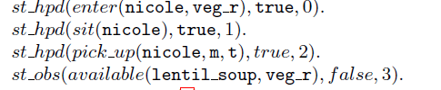
Futile Activity

Slide 40
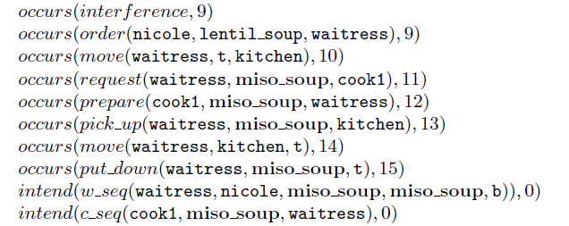

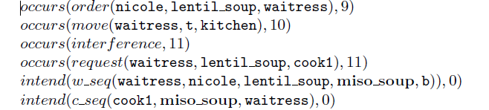
Diagnosis

Slide 41
Conclusions & Future Work
Use of Blunt et al theory of intentions! (Main character’s intentions)
Modelling a cautious reader using AIA architecture + additional knowledge
Secondary characters should be goal oriented agents as well. Keep track of intentions of multiple agents.
How to Define Futility as background knowledge so that a knowledge engineer does not need to put in efforts.

Slide 42
Limitations and Insights
The authors assume a very naïve translation from story-line to NLP. Most of their reasoning methods will fail just on that basis if we migrate it to actual Activity Recognition.
Although I really liked the idea that the manner in which the authors did a translation of the time-line and this suggests insights in activity recognition.
No Evolving Ontologies for Activity Recognition.
Multiple goal driven agents are problem for prioritizing. (in terms of event/events in question. Example in question-answering)

Slide 43
Questions & Discussion

